Slide 1
Graph
Convolutional
Reinforcement
Learning
CS 399
Seminar - Cognitive Computing

Slide 2
DISCUSSION POINTS
Overview
Previous Work
Proposed Method
Graph Convolution
Relation Kernal
Temporal Regularization
Experiments
02

Slide 3

REINFORCEMENT
LEARNING
Reinforcement learning (RL) is an area of machine learning concerned with how intelligent agents ought to take actions in an environment in order to maximize the notion of cumulative reward
Reinforcement learning is one of three basic machine learning paradigms, alongside supervised learning and unsupervised learning.
Reinforcement learning differs from supervised learning in not needing labeled input/output pairs to be presented, and in not needing sub-optimal actions to be explicitly corrected.

Slide 4

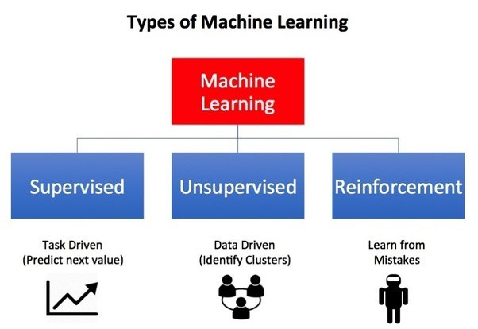
Environment — Physical world in which the agent operates
State — Current situation of the agent
Reward — Feedback from the environment
Policy — Method to map agent’s state to actions
Value — Future reward that an agent would receive by taking an action in a particular state

Slide 5
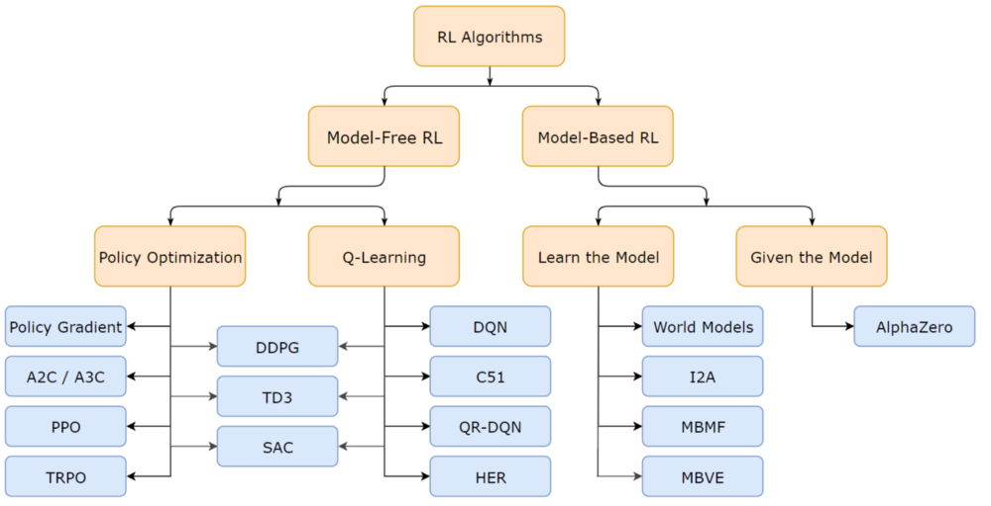
Popular RL Algorithms
Monte Carlo Methods
Temporal Difference Methods
Value-Based Methods
Deep Q Learning
4. Policy-Based Methods
Deep Deterministic
Policy Gradient

Slide 6

MULTI-AGENT RL
Amongst the various domains of Artificial Intelligence (AI) research being advanced at the moment, one domain has become critical to the broader success of artificial intelligence, while still in its infancy. It’s called multi-agent reinforcement learning.
Multi-agent reinforcement learning is the study of numerous artificial intelligence agents cohabitating in an environment, often collaborating toward some end goal.
derives inspiration from other social structures in the animal kingdom. It also draws heavily on game theory.

Slide 7
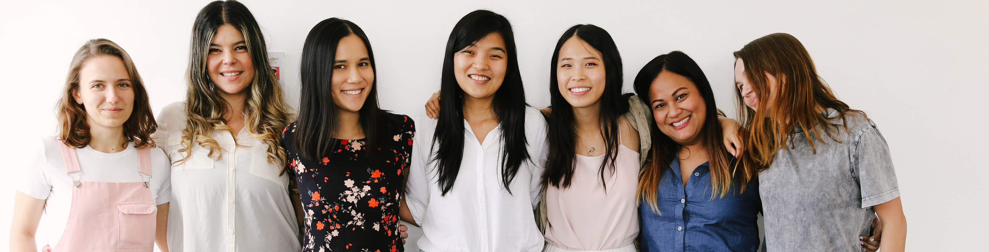
IMPORTANCE OF MARL
Multi-agent systems can be used to model many complex problems of today’s society, such as urban and air traffic control, multi-robot coordination, distributed sensing, and energy distribution.
More critical reasons for the research community to focus on multi-agent reinforcement learning: the role of sociability in increasing a species intelligence for the safe development of artificial intelligence
If we’re working toward advancing artificial intelligence, it reasonable to posit that the same sort of sociability that is so fundamental to our own intelligence will be important to advancing artificial intelligence.

Slide 8
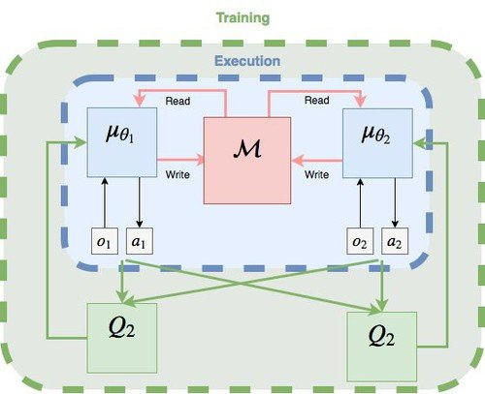
MADDPG ALGORITHM
Actor-Critic model. Wherein two separate neural networks,
one the actor and the other the critic.
An actor-network that uses local observations for deterministic actions
A critic-network that uses joint states action pairs to estimate Q-values
But in MADDPG, there is a joint critic network for all agents but individual action networks. This enables the Multi-agent system to learn a joint Q-Value
Disadvantages
But there are a few issues with this system, Namely, Communication among all agents makes it hard to extract valuable information for cooperation, while communication with only nearby agents may restrain the range of cooperation.

Slide 9
MADDPG on ML Agents

Slide 10
PREVIOUS WORK
Multi-Agent Reinforcement Learning (MARL) is usually facilitated by concepts
like communication, mean field theory, casual influence.
Mean Field Theory captures the interplay of agents by mean action. Were the
collective affect of all agents in environment is replaced by the mean
Casual Influence is s a measure of action influence, which is the policy change of an agent in the presence of an action of another agent
Disadvantages
Communication among all agents makes it hard to extract valuable information for cooperation, while communication with only nearby agents may restrain the range of cooperation
Mean action eliminates the difference among agents and thus incurs the loss of important information that could help cooperation.
Causal influence is not directly related to the reward of the environment and thus may not encourage cooperation

Slide 11
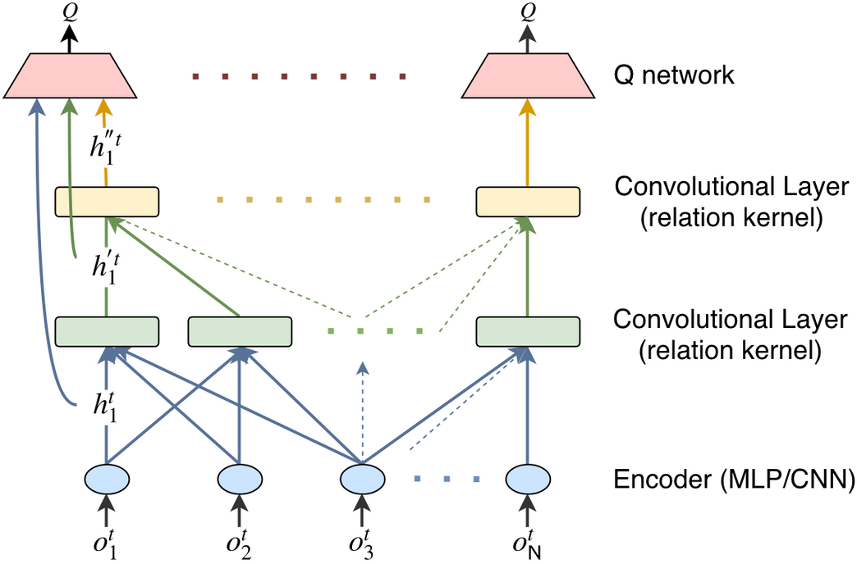
PROPOSED METHOD
Many important real-world applications come in the form of graphs,
such as social networks, protein-interaction networks, 3D point clouds.
The paper proposes to model the multi-agent environment as a graph. Where
agents are represented by the nodes of the graph and each node i has a set
of neighbors, Bi , which is determined by distance or other metrics
The intuition behind this is neighboring agents are more likely to interact
with and affect each other.
Novelty
Graph convolutional reinforcement learning, namely DGN, is instantiated based on a deep Q network and trained end-to-end. DGN shares weights among all agents, making it easy to scale.
DGN abstracts the mutual interplay between agents by relation kernels extracts latent features by convolution and induces consistent cooperation by temporal relation regularization

Slide 12
PROPOSED METHOD
The problem is formulated as Decentralized Partially Observable Markov
Decision Process (DecPOMDP)
At each timestep 't' each agent 'i' receives a local observation 'o^t i',
takes an action 'a^t i', and gets an individual reward 'r^t i'. The objective is
to maximize the sum of all agents’ expected returns.
DGN consists of three types of modules: Observation encoder,
Convolutional layer and Q network
Novelty
Observation Encoder
Convolutional Layers
Q Network

Slide 13
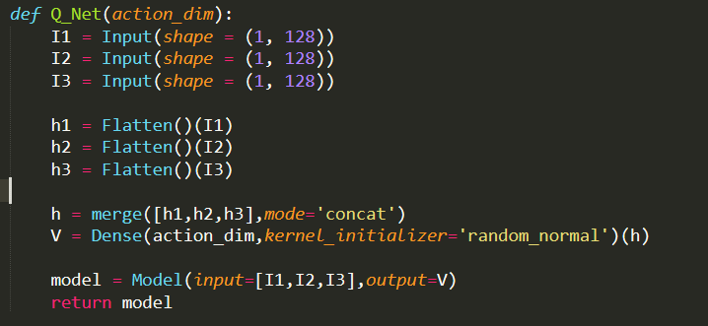
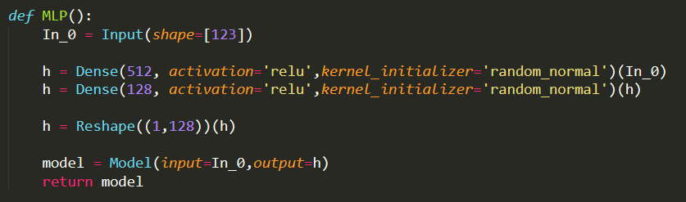

Slide 14
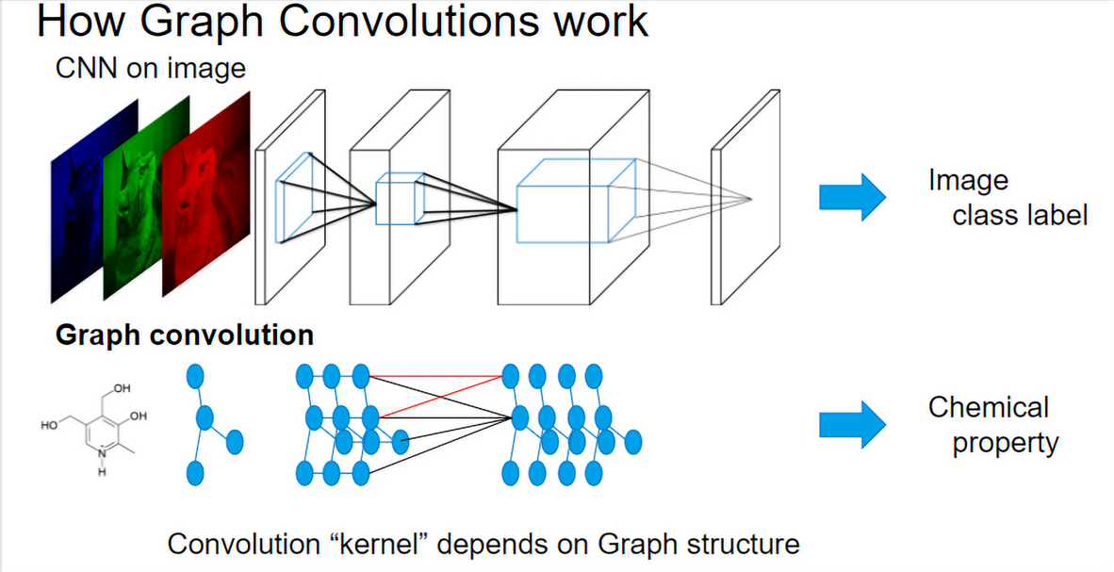
GRAPH CONVOLUTION
The local observation 'o^t i' is encoded into a feature vector 'h^t i' by MLP for
low-dimensional input or CNN for visual input
The convolutional layer integrates the feature vectors in the local region.
and generates the latent feature vector ' h'^t i'.
By stacking more convolutional layers, the receptive field of an agent
gradually grows, where more information is gathered, and thus the scope
of cooperation can also increase
Method
We merge all agents’ feature vectors at time t into a feature matrix F t with size N×L. Where N is the number of agents and L is the length of a feature vector.
We construct an adjacency matrix 'C^t i' with size (|Bi | + 1) × N for agent i
We can obtain the feature vectors in the local region of node i by 'C^t i × F^t'

Slide 15
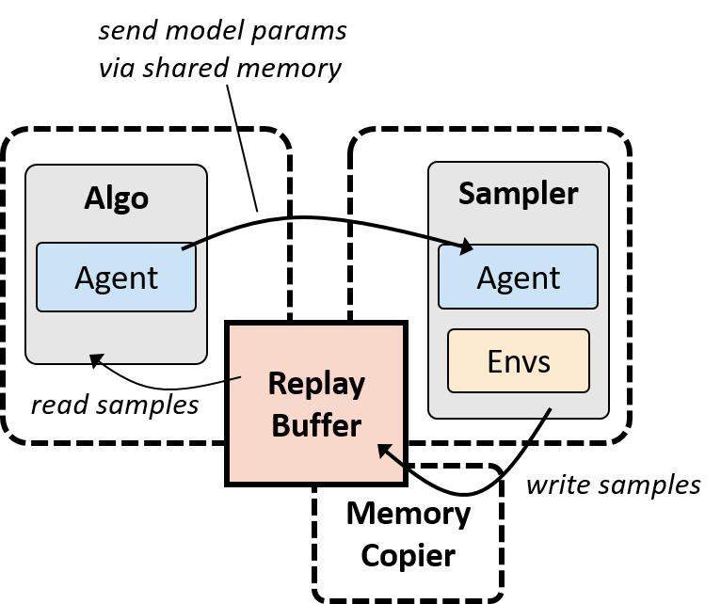
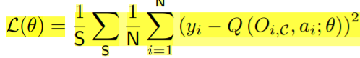
GRAPH CONVOLUTION
Method (Continued)
During training, at each timestep, we store the tuple (O, A, O' , R, C) in the replay buffer, where
O = {o1, · · · , oN} (set of observations)
A = {a1, · · · , aN} (set of actions)
O0 = {o 0 1 , · · · , o0 N } (set of next observations)
R = {r1, · · · , rN} (set of rewards)
C = {C1, · · · , CN} (set of adjacency matrix)
Then, we sample a random minibatch of size S from the replay buffer and minimize the loss

Slide 16
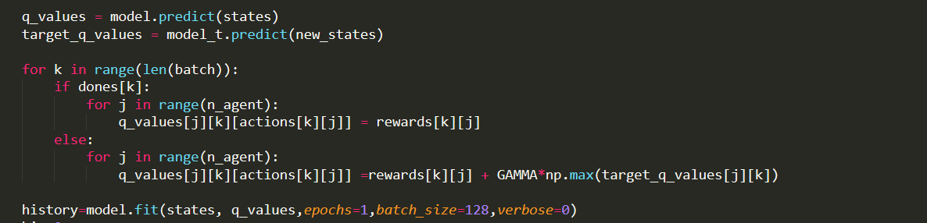
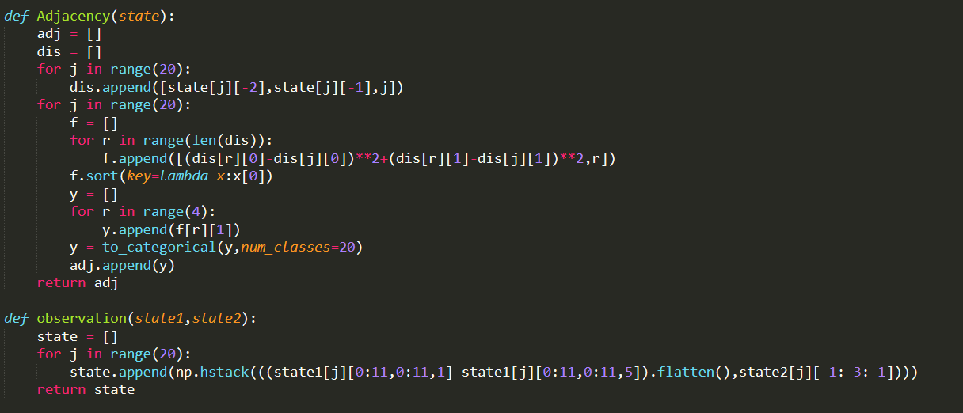

Slide 17
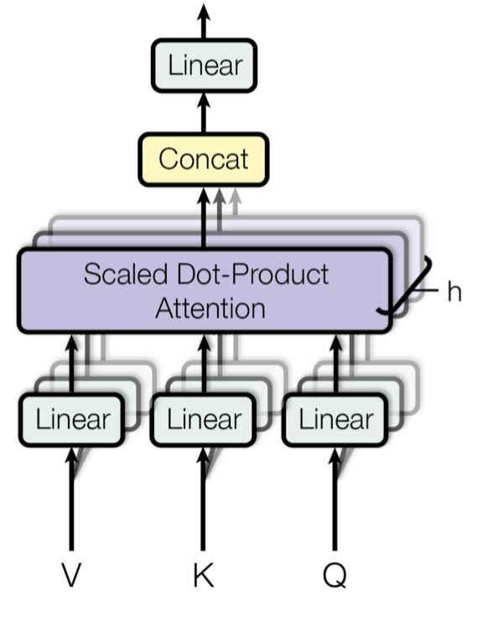
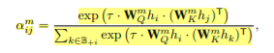
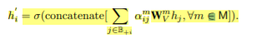
RELATION KERNAL
We use multi-head dot-product attention as the convolutional kernel to
compute interactions between an agent
For each agent i, let B+i denote Bi and i. The input feature of each agent is
projected to query, key, and value representation by each independent
attention head.
For attention head m, the relation between i and j ∈ B+i is computed as
The outputs of M attention heads for agent i are concatenated and then fed
into function σ, i.e., one-layer MLP with ReLU non-linearities, to produce
the output of the convolutional layer.

Slide 18
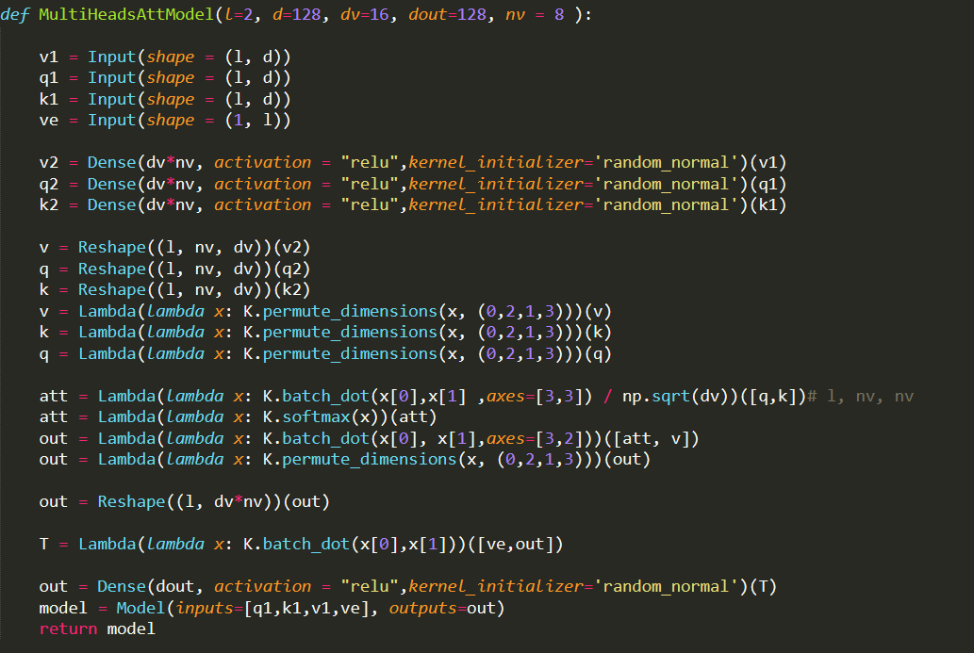

Slide 19
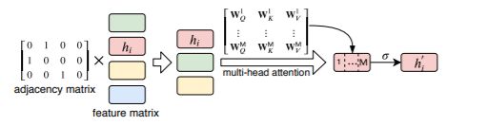
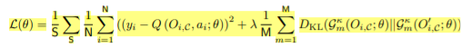
TEMPORAL REGULARIZATION
Cooperation is a persistent and long-term process. Whom to cooperate with
and how to cooperate should be consistent and stable for at least a short
period of time
Inspired by temporal-difference learning, we use the attention weight
distribution in the next state as the target for the current ones
We adopt KL divergence to measure how the current attention weight
distribution is different from the target attention weight distribution.
Minimizing the KL divergence as a regularization will encourage the agent
to form the consistent relation representation and hence cooperation.

Slide 20
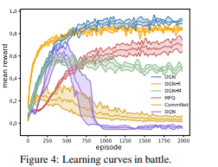
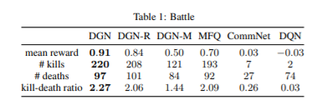
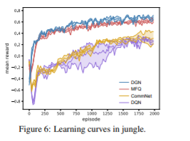
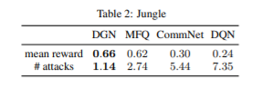
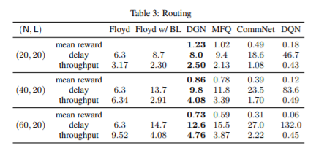
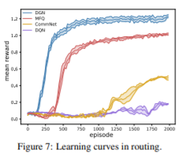
RESULTS
Battle
Jungle
Routing

Slide 23
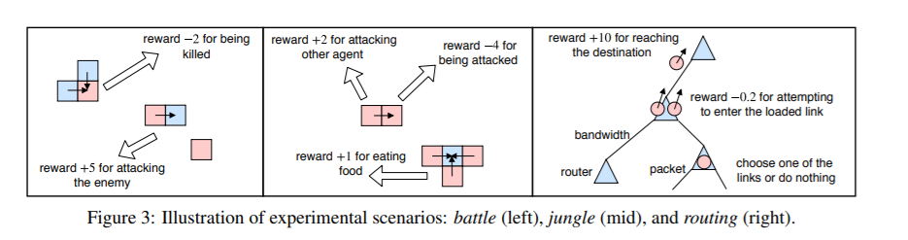
CONCLUSION
Proposed Graph Convolutional Reinforcement Learning
DGN adapts to the dynamics of the graph of the multi-agent environment.
DGN exploits convolution with relation kernels to extract latent features
from gradually increased receptive fields for learning cooperative strategies.
Moreover, the relation representation between agents are temporally
regularized to make the cooperation more consistent

Slide 24
THANK YOU!

